Slide 1
Disambiguating PP attachment sites with graded semantic data
Or, how to rule out
elephants in pajamas
Clayton Greenberg
Princeton University
May 16, 2013

Slide 2
One morning, I shot an elephant in my pajamas. How he got into my pajamas I’ll never know.
-- Groucho Marx

Slide 3
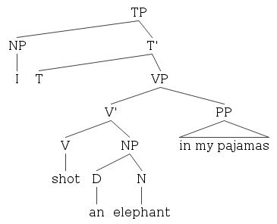
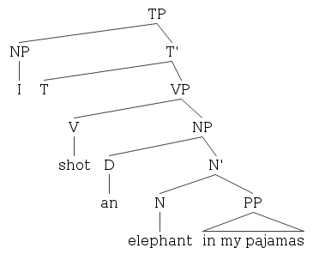
The attachment decision

Slide 4
Principles of Parsing
Right Association (Late Closure)
“Terminal symbols optimally associate to the lowest non-terminal node” (Kimball 1973, 24).
Minimal Attachment
“stipulates that each lexical item (or other node) is to be attached into the phrase marker with the fewest possible number of nonterminal nodes linking it with the nodes which are already present” (Frazier and Fodor 1978).

Slide 5
Right Association
If Right Association must hold, we would always get N-attach. In order to get V-attach, the NP must “close” so that the PP can attach higher in the tree.

Slide 6
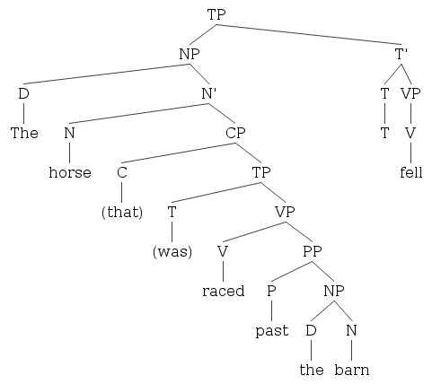
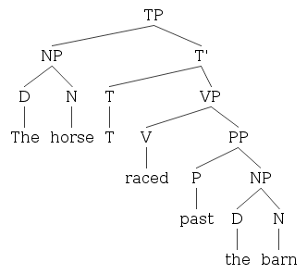
Minimal Attachment

Slide 7
Church and Patil (1982)
Attachment sites grow as Catalan function:
(1) put (“the block”, “in the box on [the table in the kitchen]”)
(2) put (“the block”, “in [the box on the table] in the kitchen”)
(3) put (“the block in the box”, “on the table in the kitchen”)
(4) put (“the block in [the box on the table]”, “in the kitchen”)
(5) put (“[the block in the box] on the table”, “in the kitchen”)

Slide 8
WordNet
Ordered hierarchy of synsets, per POS.
Synsets contain words, glosses, hypernyms and hyponyms.
Equipped to help with data sparsity.
Provides semi-unsupervised dimensions to data.
Perhaps able to capture generalizations about PP-attachment behaviors.

Slide 9
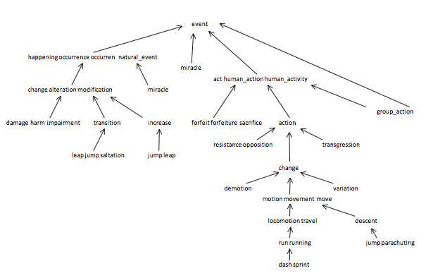

Slide 10
Word Sense Hierarchy for “kayak”
kayak (n.)
direct hypernym: canoe
direct hypernym: small boat
direct hypernym: boat
direct hypernym: vessel, watercraft
direct hypernym: craft
direct hypernym: vehicle
direct hypernym: conveyance, transport
direct hypernym: instrumentality, instrumentation
direct hypernym: artifact, artefact
direct hypernym: whole, unit
direct hypernym: object, physical object
direct hypernym: physical entity
direct hypernym: entity

Slide 11
Using hypernyms
I ate my food with a spork
I ate my food with an eating utensil (hypernym)
I ate my food with a fork
I ate my food with a spoon
I gobbled my food with a spork
I consumed my food with a spork

Slide 12
Other parts of the WordNet database
Beyond hierarchies and glosses.
Teleological links: subjects were asked what do you use a shovel for? Scissors? Oven?
Evocation database: subject were given pairs of words and asked how much one word evokes the other.
See -> telescope (weak).
Telescope -> see (strong).

Slide 13
Hindle and Rooth (1993)
(1) track the number of times verbs and nouns appear without prepositions
(2) classify as verb-attach if noun1 is a pronoun (1.8% of our data)
(3) classify as verb-attach if the verb is passivized
(4) classify as noun-attach if there is no viable verb to attach to
(5) if the unambiguous classifications made previously show that one classification is significantly more likely than the other for the current data point, assign accordingly
(6) if the co-occurrence of the verb and preposition differs significantly from the co-occurrence of noun1 and preposition, classify accordingly
(7) classify the remainder as noun-attach.
Accuracy: 80%

Slide 14
From Ratnaparkhi et al. 1994
0 join board as director V
1 is chairman of N.V. N
2 named director of conglomerate N
3 caused percentage of deaths N
5 using crocidolite in filters V
6 bring attention to problem V
9 is asbestos in products N
12 led team of researchers N
13 making paper for filters N
16 including three with cancer N
18 is finding among those N
22 is one of nations N

Slide 15
Brill and Resnik (1994)
Used WordNet hierarchies and transformation-based learning to induce rules for PP attachment.
Human readable output.
Accuracy: 81.8%

Slide 16
Collins and Brooks (1995)
Training corpus enhancements:
Replaced four digit numbers with “YEAR,”
Replaced other numbers with “NUM.”
Verbs and prepositions were converted to all lowercase.
In nouns, all words that started with an uppercase letter followed by a lowercase letter were replaced with “NAME.”
All strings NAME-NAME were replaced with NAME.
All verbs were automatically lemmatized.
Accuracy: 84.5%

Slide 17
Stetina and Nagao (1997)
Developed a custom word sense disambiguation system for PP-attachment
Used decision trees as learning algorithm
Industry leader on Ratnaparkhi dataset with accuracy of 88.1%

Slide 18
Results by method
Method | Percentage Accuracy
Always N-attach | 59.0
Most likely for each preposition | 72.2
Hindle and Rooth (1993) | 80.0
Ratnaparkhi et al. (1994) | 81.6
Brill and Resnik (1994) | 81.8
Collins and Brooks (1995) | 84.5
Stetina and Nagao (1997) | 88.1
Average Human (quadruple) | 88.2
Average Human (whole sentence) | 93.2

Slide 19
Two kinds of prepositions
The rabbit is in the hat.
The rabbit is on the hat.
The rabbit is with the hat.
She was blamed for the crime.
She was accused of the crime.
She was charged with the crime.

Slide 20
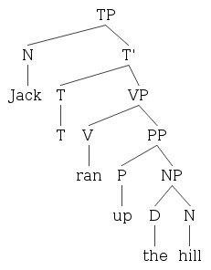
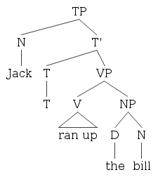
Phrasal Verbs

Slide 21
The of generalization
There is a “general tendency” that complements merge first, then adjuncts, then specifiers.
of PPs seem to always Merge first, implying a complement relation:
A game of cards with incalculable odds.
*A game with incalculable odds of cards.

Slide 22
Either by implementing a TBL system or having the insight to divide the corpus into preposition groups, one would discover that the Ratnaparkhi corpus shows of PPs attaching to nouns…
99.1%
of the time.
The only exceptions are phrasal verbs like accuse of and misclassifications. And, of happens to be the most frequent preposition in English.

Slide 23
Graded judgments of PP-attachment sites
I saw the woman with the telescope.
I saw the woman with the red glasses.
I saw the woman with the handbag.

Slide 24
Functions of PPs
Verb-attach PPs tend to be
(1) instruments (the object with which the action is performed)
(2) locatives (where the action takes place)
(3) goals (where or to whom the action is leading)
(4) sources (where or from whom the action initiated)
(5) manners (how or when the action occurs).

Slide 25
Methods I: Amazon Mechanical Turk
Cleaned up Ratnaparkhi’s corpus.
Deleted the missing quadruples, removed influential errors from Abney et al. (1999) and others as encountered, and adopted Collins and Brooks (1995) enhancements.
Found the original sentence for each quadruple in the Penn Treebank.
Programmatically determined three disambiguating glosses for each quadruple.
Presented MTurkers with the original and glosses. They are asked to rate meaning quality from 1 to 5.

Slide 26
EXAMPLES:
Original sentence: One morning, I shot an elephant in my pajamas
GOOD: shot in my pajamas, an elephant
EXCELLENT: shot while in my pajamas, an elephant
FAIR: an elephant could be in my pajamas
This sentence has two possible meanings. In one meaning, the shooter is wearing pajamas. In the other, the elephant is wearing pajamas. The first meaning is more reasonable, so it gets a higher rating. The "while" makes the second phrase clearer than the first: the shooter is not shooting into the pajamas. Therefore, the second phrase gets a higher rating than the first.
Original sentence: He saw the woman with the telescope.
EXCELLENT: saw with the telescope, the woman
NEUTRAL: saw while with the telescope, the woman
EXCELLENT: the woman could be with the telescope
This sentence has two possible meanings. In one meaning, "he" used the telescope to see the woman. In the other, the woman has the telescope. Both meanings seem equally reasonable. However, perhaps you have a preference for one over the other. There is NO CORRECT answer. The second phrase is less clear about whether he used the telescope to see the woman, so it gets a lower rating.
Original sentence: He saw the woman with the handbag.
POOR: saw with the handbag, the woman
POOR: saw while with the handbag, the woman
EXCELLENT: the woman could be with the handbag
This sentence has one possible meaning. The woman has the handbag. "He" did not use the handbag to see the woman. This is the only CORRECT answer. If the sentence has only one meaning, please rate the phrase with the correct meaning with EXCELLENT and the other(s) with POOR. If you do not get most of these correct, we may not accept your submission for payment.

Slide 27
Methods II: Nearest Neighbor and Decision Trees
Combine: Ratnaparkhi classifications, WordNet senses, instrument distances from morphosemantic links and evocations, and idiom list.
3,000 idioms. Not edited by hand.
Presence on the list ended up being the highest node of the decision tree, as expected.

Slide 28
Results I: the binary classifier
Correctly Classified Instances 17339 89.0230 %
Incorrectly Classified Instances 2138 10.9771 %
Total Number of Instances 19477
=== Confusion Matrix ===
a b <-- classified as
8546 599 | a = V
1539 8793 | b = N

Slide 29
Results II: graded judgment regression
Correlation coefficient 0.2165
We can divide the human judgments into three groups: unvaried V-attach, unvaried N-attach, varied.
The varied data was enough to override the correlation.
Many reasons for variation: paraphrases were awkward, occasional actual ambiguity, misfire on idioms.
There were barely any false positives, but many false negatives, due to sparseness of inter-POS links in WordNet

Slide 30
Conclusion and Future Work
Many improvements resisted: clean up idiom list, delete bad test points, throw out quadruples with non-WordNet words, etc.
Connect to frame semantics?
Investigate further why people have the intuitions that they do when the context is underspecified.
Find better applications for the graded judgment corpus.

Slide 31
Bonus: Translating Persian Prepositions
Over the summer, I adapted a version of TBL to translate prepositions from Persian into English.
The system exclusively used the word forms, a programmatically determined “governor” (essentially the attachment site), and the object.

Slide 32
Persian Example
Hassan bx Maryym azdwaj Krd .
Literally, John with Mary got married
‘John married Mary.’
So, we need a rule that says, “If the governor is azdwaj Krdn, delete bx instead of translating it to with.

Slide 33
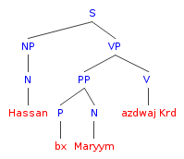
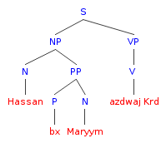
Attachment woes
What we wanted:
What we got:

